Slide 1

Introduction to Statistical Inference II
EDUC 641: Week 5
Cengiz Zopluoglu

Slide 2
Goals
Build intuition for the t-distribution and degrees of freedom; contrast with the normal.
Conduct and interpret one-sample, independent-samples, and dependent-samples t- tests.
Choose the right variant (one- vs two-tailed; pooled vs Welch’s) and justify the choice. Write clear APA-style results.

Slide 3
One-sample t-test (NHST)

Slide 4
One-sample t-test
In a one-sample z-test, we assume that the population standard deviation (σ) is known.
In reality, we almost never know the population standard deviation. Instead, we estimate it using the sample standard deviation:
σ → σ^
We use the sample standard deviation as our best estimate of the population standard deviation.
This substitution changes the shape of the sampling distribution — we can no longer use the normal distribution.
Instead, we work with a t-distribution.
The t-distribution accounts for additional uncertainty when estimating σ from a sample.
Aside from this change, the inference process is conceptually the same as with the z- test.

Slide 5
What is a t-distribution?
A t-distribution looks very similar to the standard normal distribution, N(0,1).
The key difference is that it depends on a parameter called the degrees of freedom (df).
As the degrees of freedom increase, the t-distribution becomes closer to the normal distribution.
So:
Small samples → heavier tails (more uncertainty) Large samples → approaches normal

Slide 6
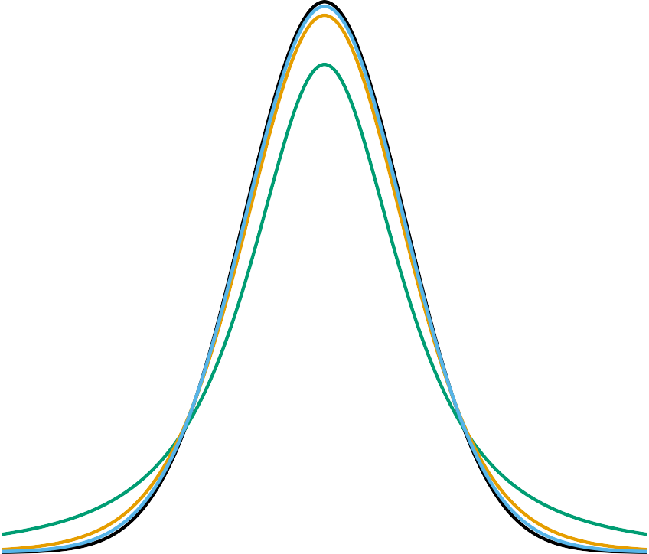

Comparing t-distributions
Below are t-distributions with df = 2, 10, 30, and the standard normal distribution.
Notice how the tails shrink as df increases.
This reflects increasing precision with larger samples.

Slide 7




t distribution functions in R
Function | Purpose | Example
dt() | Density at a given t-score | dt(-1, df = 10)
pt() | Cumulative probability up to a t-score | pt(-1, df = 10)
qt() | Quantile (critical value) for a given probability | qt(.025, df = 10)
dnorm(x = -1, mean = 0, sd = 1)
dt(x = -1, df=10)
[1] 0.2419707
[1] 0.230362

Slide 8




P (z ≤ −1) =?
P (t ≤ −1) =?
pnorm(q
mean sd
lower.tail
= -1,
= 0,
= 1,
= TRUE)
pt(q
df lower.tail
= -1,
= 10,
= TRUE)
[1] 0.1704466
[1] 0.1586553

Slide 9
A comparison of probability values for the standard normal distribution and t-distribution with degrees of freedoms are equal to 30 and 100 and 1000.
Normal Distribution |  | t-distribution
 |  |  | df = 30 | df = 100
P (z ≤ −3) | 0.00135 | P (t ≤ −3) | 0.00269 | 0.00170
P (z ≤ −2) | 0.02275 | P (t ≤ −2) | 0.02731 | 0.02411
P (z ≤ −1) | 0.15866 | P (t ≤ −1) | 0.16265 | 0.15986
P (z ≤ 0) | 0.50000 | P (t ≤ 0) | 0.50000 | 0.50000
P (z ≤ 1) | 0.84134 | P (t ≤ 1) | 0.83735 | 0.84014
P (z ≤ 2) | 0.97725 | P (t ≤ 2) | 0.97269 | 0.97589
P (z ≤ 3) | 0.99865 | P (t ≤ 3) | 0.99731 | 0.99830
As the degrees of freedom increases, t-distribution probabilities converge to z- distribution probabilities.

Slide 10
Steps in a One-Sample t-Test
State the hypotheses
H0 : μ = test value
H_{A} : μ ≠, > , < test value
Determine the test type (one-tailed or two-tailed)
Compute the t-statistic:
t =
X¯ − μ X¯ − μ
σ_{X}¯
=
σ^/√N
Find the p-value from the t-distribution with N − 1 degrees of freedom.
Compare with significance level α (e.g., 0.05) and make a decision whether to reject the null hypothesis.
Interpret the result in context.

Slide 11
Example: Intervention and Infant Development
Research question: Does a specially designed intervention for mothers of low-birthweight (LBW) infants improve their infants’ later psychomotor development?
Background: Researchers created an intervention program for mothers of LBW infants. The goal was to help mothers become more aware of their infants’ cues and more responsive to their needs—behaviors believed to reduce developmental difficulties later in life.
Dependent variable: Psychomotor development, measured by the Psychomotor Development Index (PDI). In the general population (normal-weight infants), PDI scores are scaled to have a mean of 100.
Independent variable: Intervention status — whether the mother participated in the program.
Sample data: A researcher collected PDI scores from 56 LBW infants at 6 months old, after their mothers had participated in the intervention shortly after birth. The sample had the following summary statistics:
N = 56
X¯ = 104.125
σ^ = 12.584

Slide 12
Null hypothesis: The intervention has no effect. The average PDI score for the LBW infants
is not different than 100 when their mothers are exposed to the designed intervention.
H₀ : μ = 100
Alternative hypothesis: The intervention has a significant effect. The average PDI score for the LBW infants is higher than 100 when their mothers are exposed to the designed intervention.
H_{A} : μ > 100
Solution:
N = 56
X¯ = 104.125
σ^ = 12.584
t =
X¯ − μ
=
104.125 − 100
= 2.453
σ_{X}¯
12.584/√56
Due to the direction of alternative hypothesis:
This is a one-tailed test.
We are looking for the upper tail probability in a t-distribution with 55 degrees of freedom.

Slide 13


The probability of observing a t- statistic of 2.453 or more extreme is equal to 0.009.
If the null hypothesis were true, the probability of observing a sample mean of 104.125 or a higher mean in our study with 56 infants would be 0.009.
If we use the significance level of 0.05 ( α = 0.05 ), then we reject the null hypothesis, p = 0.009 < 0.05.
Therefore, we decide there is enough evidence to argue that the designed intervention indeed improved the psychomotor ability for low- birthweight infants.
P (t ≥ 2.453) =?
pt(q = 2.453,
df = 55,
lower.tail = FALSE)
[1] 0.008682876

Slide 14
Effect Size
It is also strongly recommended to report effect size along with a statistically significant result.
A common effect size measure for t-tests is Cohen’s d
In the context of a one-sample t-test, Cohen's d measures how much standard deviation the sample mean is further away from the null value.
′
X¯ − μ 104.125 − 100
Cohen sD =
= = 0.328
σ^ 12.584

Slide 15
APA Style Write-Up
The average PDI scores for 56 infants whose mothers were trained during the designed intervention was 104.13 with a standard deviation of 12.58. A one-sample t-test was conducted to test whether or not the average PDI score was significantly different than 100, the mean PDI score for a normative population. Based on the results of a one-sample t-test, there was a significant effect of the designed intervention for mothers on the psychometric ability of low-birth infants, t(55)=2.453, p = 0.009, Cohen’s d = 0.33.

Slide 16
Independent samples t-test

Slide 17
Independent Samples t-Test
When to Use
Used when comparing two distinct groups representing two different populations.
Each participant belongs to only one group — the groups are independent of each other.
The goal is to determine whether there is a significant difference in the outcome variable between the two groups.
Example Scenario ([Aronson et al., 1999]
(https://www.sciencedirect.com/science/article/pii/S0022103198913713))
Stereotype threat: Individuals from a stereotyped group may experience anxiety in situations where their behavior could confirm a negative stereotype.
This pressure can impair performance, reducing achievement compared to when no stereotype threat is present.
Research hypothesis: White male college students perform worse on a math exam when exposed to a stereotype threat.

Slide 18
Study Design
Two independent groups of college students who excelled in mathematics and valued high performance in the subject.
Control group (n = 11): Students were simply asked to complete a difficult mathematics exam.
Threat condition (n = 12): Students were told that Asian students typically outperform others on math tests, and that the exam aimed to understand why this difference exists.
This instruction was expected to trigger stereotype threat among white students, thereby reducing their performance.
Data
Control condition: 4, 9, 12, 8, 9, 13, 12, 13, 13, 7, 6
Experimental condition: 7, 8, 7, 2, 6, 9, 7, 10, 5, 0, 10, 8

Slide 19
White male college students perform lower in a math exam when exposed to a stereotype threat.
Dependent variable:
Independent variable:
Null Hypothesis:
Alternative hypothesis:

Slide 20
Descriptive Statistics
Group | N | Mean | SD | Skewness | Kurtosis
Control | 11 | 9.64 | 3.17 | -0.31 | -1.48
Experimental | 12 | 6.58 | 3.03 | -0.86 | -0.39
The experimental group scored lower on average than the control group.
Does this difference reflect a true effect of stereotype threat, or could it be due to random chance?
If another researcher replicated the study with similar sample sizes (N₁ = 11, N₂ = 12), Would they find a difference?
Would it be in the same direction?
Can we visualize this process as sampling from two populations, and think in terms of the sampling distribution of the difference in means?

Slide 21
Sampling Distribution of the Difference in Means
Suppose that the population means for the two groups are equal and both equal 8.04:
μ₁ = μ₂ = 8.04
Also, assume that the population standard deviations are equal and both equal 3.4:
σ₁ = σ₂ = 3.4
Randomly sample 11 individuals from Population 1 and compute X¯₁.
Randomly sample 12 individuals from Population 2 and compute X¯₂.
Compute the difference in sample means: X¯1 − X¯2.
Repeat Steps 1–3 many times.
Plot the sampling distribution of the differences in sample means.

Slide 22
# Sample 11 individuals from Population 1
s1 <- rnorm(n = 11, mean = 8.04, sd = 3.4) # Sample 12 individuals from Population 2 s2 <- rnorm(n = 12, mean = 8.04, sd = 3.4) # Compute the means
mean(s1)
[1] 6.746864
mean(s2)
[1] 7.517138
# Difference in sample means
mean(s1) - mean(s2)
[1] -0.770274

Slide 23

# Repeat the same process 10,000 times
diff.in.means <- replicate(n = 10000,
expr = {
s1 <- rnorm(n = 11, mean = 8.04, sd = 3.4) s2 <- rnorm(n = 12, mean = 8.04, sd = 3.4) mean(s1) - mean(s2)
}
)
# Descriptive statistics
require(psych) describe(diff.in.means)
vars n mean sd median trimmed mad min max range skew kurtosis se X1 1 10000 -0.02 1.42 -0.02 -0.02 1.43 -4.93 5.4 10.33 0.01 -0.08 0.01
# Sampling distribution of differences in sample means
hist(diff.in.means,col='white',xlab = '')

Slide 24

Given that the observed difference in our experiment is 3.06, how likely is it to observe a difference of 3.06 or more extreme between two groups assuming the population mean for both groups are equal?

Slide 25
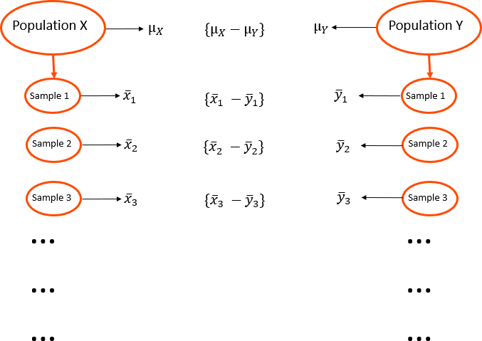

Slide 26
Central Limit Theorem (Again!)
Given two populations — Population 1 with mean μ₁ and standard deviation σ, and Population 2 with mean μ2 and standard deviation σ —
the sampling distribution of the difference in sample means is approximately normal, with:
Mean:
μ_{X}¯_{1−X}¯₂ = μ1 − μ2
Standard Deviation:
σ = √
σ
2 _{σ}2
X¯₁−X¯₂
n
+
n
1 2
where n1 and n2 are the sample sizes for the two groups.

Slide 27
Estimating the Population Standard Deviation
In practice, we rarely know the population standard deviation.
Instead, we estimate it using data from both samples and compute a pooled standard deviation, an approximation of the common population standard deviation.
√
(n − 1)σ
2
2
2
1
^ + (n
2
− 1)σ^
σ^ =
1
n₁ + n₂ − 2
The sample sizes do not need to be equal for this calculation.
Because we replace the true population standard deviation with an estimate,
the sampling distribution of the difference in sample means follows a t-distribution with degrees of freedom:
df = n₁ + n₂ − 2

Slide 28
Steps to Compare the Means of Two Independent Samples
1.State the hypotheses
Null hypothesis:
H₀ : μ₁ = μ₂ or H₀ : μ₁ − μ₂ = 0
Alternative hypothesis (depending on the research question):
H_{A} : μ₁ ≠ μ₂ (two-tailed)
or
H_{A} : μ₁ > μ₂ or H_{A} : μ₁ < μ₂ (one-tailed)
2.Compute the pooled standard deviation
√
2
2
2
(n − 1)σ^ + (n
− 1)σ^
σ^_{p} =
1
1 2
n₁ + n₂ − 2
3.Compute the standard error of the difference in sample means
√
σ^
2
σ^²
p p
SE_{X}¯_{1−X}¯₂ =
n
+
n
1 2
4.Compute the t-statistic
t =
X¯₁ − X¯₂
^{SE}X¯1−X¯2
5.Find the p-value
Determine the p-value associated with the computed t-statistic and decide whether the observed difference in sample means is compatible with the null hypothesis.

Slide 29
Null Hypothesis (H₀)
White male college students in the stereotype threat condition perform equally wel on a math exam as those in the control condition.
H₀ : μ₁ − μ₂ = 0
Alternative Hypothesis (H_{A})
White male college students in the stereotype threat condition perform worse on a math exam than those in the control condition.
H_{A} : μ₁ − μ₂ > 0
Pooled Standard Deviation
√
σ^_{p} =
(11 − 1)(3.17)² + (12 − 1)(3.03)²
= 3.097
11 + 12 − 2
t-Statistic
9.64 − 6.58
t = = 2.361
√
3.097
2
+
3.097
2
11
12
p-value
P (t ≥ 2.361) =?

Slide 30
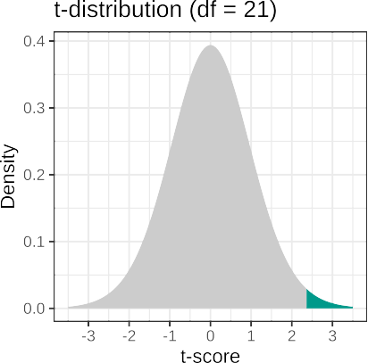
If we assume that the null hypothesis is true (the white male college students in the stereotype threat condition perform equally well as those in the control condition), the probability of observing a mean difference of 3.06 points or more extreme is 0.014.
P (t ≥ 2.361) =?
At a significance level of 0.05, we reject the null hypothesis. This suggests that the observed data are not compatible with the assumption that both groups perform equally well.
pt(q = 2.361,
df = 21,
lower.tail = FALSE)
[1] 0.01398506

Slide 31
Effect Size
As discussed earlier for the one-sample t-test, a statistically significant result alone does not convey the magnitude or practical importance of the effect.
A statistically significant result should always be accompanied by an appropriate effect size measure.
For an independent samples t-test, Cohen’s d is calculated as:
′
|X¯1 − X¯2| |9.64 − 6.58|
Cohen s d =
σ^
= = 0.988
p
3.097
A Cohen’s d = 0.99 indicates a large effect size,
suggesting that the difference in performance between the two groups is substantial.

Slide 32
APA Style Write-Up
The average test score was 9.64 (SD = 3.17) for 11 students in the control condition, and 6.58 (SD = 3.03) for 12 students in the experimental condition, in which students were exposed to a stereotype threat.
An independent-samples t-test was conducted to examine whether students under stereotype threat performed significantly worse than those in the control condition. Results indicated that the mean score in the experimental condition was 3.06 points lower than in the control condition, a difference that was statistically significant, t(21) = 2.361, p =
.014, Cohen’s d = 0.99.
These results suggest that exposure to stereotype threat substantially reduced math performance among white male college students.

Slide 33
Equal Variance Assumption
One of the key assumptions of the independent samples t-test is that the two populations have equal variances.
This assumption is the reason we computed a pooled standard deviation estimate (σ^_{p}
).
When the equal variance assumption does not hold, the resulting p-value may be inaccurate, potentially leading to incorrect conclusions about the null hypothesis.
However, it is possible to perform an independent samples t-test without assuming equal variances:
This version is known as Welch’s t-test.
The formulas for the test statistic and degrees of freedom differ slightly (see Ch. 13.4 in Learning Statistics with R).
Note that this will change the inferential statistics — be sure to report these values if you choose not to assume equal variances.

Slide 34
An independent-samples Welch’s t-test was conducted to examine whether students in the experimental condition scored significantly lower than those in the control condition. Results indicated that the mean test score in the experimental condition was 3.06 points lower than in the control condition, a difference that was statistically significant, t(20.61) = 2.356, p = .014, Cohen’s d = 0.99.
The average test score was 9.64 (SD = 3.17) for 11 students in the control condition, and 6.58 (SD = 3.03) for 12 students in the experimental condition, in which students were exposed to a stereotype threat.
These results suggest that exposure to stereotype threat substantially reduced math performance among white male college students.

Slide 35
Dependent samples t-test

Slide 36
When to Use:
The same group of subjects is measured on two occasions, conditions, or time points.
The scores are not independent, since data are collected from the same participants.
The researcher aims to determine whether the average outcome changes between the two conditions, for example, before and after an intervention or treatment.
Example Research Hypotheses:
A track athlete’s 400-meter run time will be significantly shorter after 6 weeks of high-altitude training.
Participants will lose a significant amount of weight after following a strict keto diet for 4 weeks.
Patients diagnosed with anorexia will gain weight after participating in a newly developed family therapy program.

Slide 37
Patients diagnosed with anorexia will gain weight after participating in a newly developed family therapy program.
Dependent variable:
Independent variable:
Null Hypothesis:
Alternative hypothesis:

Slide 38
Research Hypothesis
Patients diagnosed with anorexia will gain weight after participating in a newly developed family therapy program.
17 patients diagnosed with anorexia
Weight recorded before beginning family therapy
Weight recorded after 4 weeks of therapy
The same participants were measured twice.
The goal is to test whether average weight increased following the intervention
ID | Before | After
1 | 83.8 | 95.2
2 | 83.3 | 94.3
3 | 86.0 | 91.5
4 | 82.5 | 91.9
5 | 86.7 | 100.3
6 | 79.6 | 76.7
7 | 76.9 | 76.8
8 | 94.2 | 101.6
9 | 73.4 | 94.9
10 | 80.5 | 75.2
11 | 81.6 | 77.8
12 | 82.1 | 95.5
13 | 77.6 | 90.7
14 | 83.5 | 92.5
15 | 89.9 | 93.8
16 | 86.0 | 91.7
17 | 87.3 | 98.0

Slide 39
Research Hypothesis
Patients diagnosed with anorexia will gain weight after participating in a newly developed family therapy program.
ID | Before | After
1 | 83.8 | 95.2
2 | 83.3 | 94.3
3 | 86.0 | 91.5
4 | 82.5 | 91.9
5 | 86.7 | 100.3
6 | 79.6 | 76.7
7 | 76.9 | 76.8
8 | 94.2 | 101.6
9 | 73.4 | 94.9
10 | 80.5 | 75.2
11 | 81.6 | 77.8
12 | 82.1 | 95.5
13 | 77.6 | 90.7
14 | 83.5 | 92.5
15 | 89.9 | 93.8
16 | 86.0 | 91.7
17 | 87.3 | 98.0
X¯_{before} = 83.23
X¯_{after} = 90.49
σ^_{before} = 5.02
σ^_{after} = 8.48
Could the observed weight gain have occurred by chance?
If we repeated this study with another group of 17 patients, would we expect a similar result?
What is the sampling distribution of the mean weight difference (After − Before)?

Slide 40
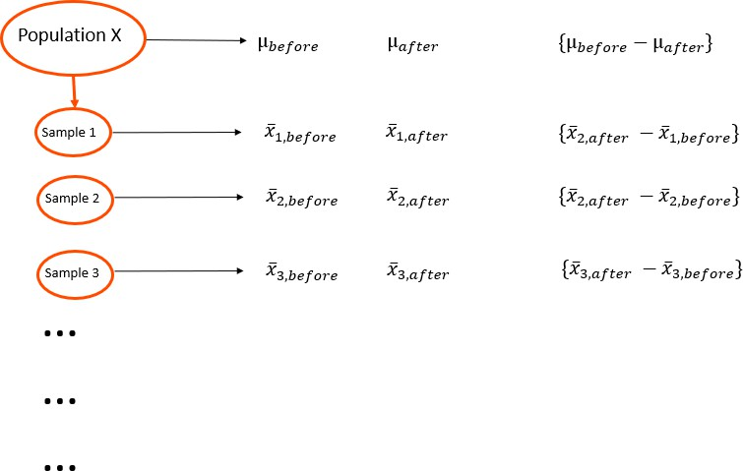

Slide 42
Research Hypothesis
Patients diagnosed with anorexia will gain weight after participating in a newly developed family therapy program.
A dependent-samples t-test is conducted by analyzing the difference scores (After − Before).
Conceptually, it is equivalent to performing a one-sample t-test on the difference scores, where the null hypothesis states that the mean difference equals zero.
ID | Before | After
1 | 83.8 | 95.2
2 | 83.3 | 94.3
3 | 86.0 | 91.5
4 | 82.5 | 91.9
5 | 86.7 | 100.3
6 | 79.6 | 76.7
7 | 76.9 | 76.8
8 | 94.2 | 101.6
9 | 73.4 | 94.9
10 | 80.5 | 75.2
11 | 81.6 | 77.8
12 | 82.1 | 95.5
13 | 77.6 | 90.7
14 | 83.5 | 92.5
15 | 89.9 | 93.8
16 | 86.0 | 91.7
17 | 87.3 | 98.0
_{X}¯
D
= 7.26 σ^
D
= 7.16
These values summarize the average weight change and its variability across the 17 participants.

Slide 43
H0 : μafter = μbefore
HA : μafter > μbefore
HA : μafter − μbefore > 0 H_{A} : μD > 0
H0 : μafter − μbefore = 0
H0 : μD = 0
X¯D = 7.26
σ^_{D} = 7.16
X¯_{D} − μ_{D}
_{X}¯_{D}
t =
=
σ^_{D} /√N
σ^_{D} /√N
7.26
t = = 4.18
7.16/√17
df = N − 1 = 17 − 1 = 16
pt(q
= 4.18,
df = 16,
lower.tail = FALSE)
[1] 0.0003537404

Slide 44
Effect Size
Cohen’s d for a dependent-samples t-test can be calculated as:
_{X}¯_{D}
7.26
′
Cohen s d =
σ^
= _{7.16} = 1.01
D
Here, the standard deviation of the difference scores was used to standardize the effect size.
There is no universal agreement on which standard deviation to use for dependent- samples t-tests.
Alternatives include using the pre-treatment standard deviation or the post- treatment standard deviation.
As long as you report the relevant values and are transparent about your calculation method, your approach is acceptable.

Slide 45
APA Style Write-Up
The average weight of 17 patients diagnosed with anorexia was 83.23 lbs (SD = 5.02) before the family therapy, and increased to 90.49 lbs (SD = 8.48) after the therapy.
A dependent-samples t-test was conducted to determine whether the average weight gain following therapy was statistically significant. Results indicated that patients gained an average of 7.26 lbs, and this increase was statistically significant, t(16) = 4.18, p < .001, Cohen’s d = 1.02.
These results suggest that the family therapy had a large and meaningful impact on weight gain among patients with anorexia.

